Slide 1
FISWG
November 13, 2019

Slide 2
DISS update
FISWG
Rebecca DeVore
Security Representative

Slide 3
Objective
Provide updates to DISS since rollout
Review submitting CSRs and receiving RFAs
Creating categories and relationships if Subject Details is unavailable
Continuous Evaluation listed in DISS
Locations to find help
Disclaimer: This information is provided as Lockheed Martin opinion gathered via our access and understanding
of the system. This presentation in no way reflects guidance provided by the government and should not be considered official.

Slide 4
Updates to DISS Since Rollout
Ability to move SMOs within your own SMO tree
Mandatory submission of CSRs in DISS
RFAs being mainly received in DISS and not in JPAS
Continuous Evaluation viewable in DISS

Slide 5
Submitting CSRs and Receiving RFAs
Reminder, as of August of this year, RRUs are no longer accepted in JPAS
All requests to the government should be submitted as CSRs (Customer Service Requests) in DISS
CSRs are submitted under the Subject Details hyperlink
If this is not available, a category or relationship may need to be added to the record
Not all CSRs will be available; if the one you need is not showing, you can submit under Supplemental Information
Most if not all CAF messages are being received in DISS as RFAs
If you haven’t been using DISS or have not been provisioned, it is highly recommended to do so

Slide 6
Creating categories
When searching an individual and the subject details hyper-link does not appear next to the name, look for the following:
Is Industry listed in the Categories?
Are there relationships for this individual for your company?
Step 1. Click on Add Category
Step 2. Open drop down and select Industry
(Note: if Industry is not in your drop down, you
will need to contact DMDC for assistance)
Step 3. Select Next
FOUO

Slide 7
Creating relationships
In some instances, relationships did not push from JPAS or relationships were pushed with no category.
This is how to build the relationships in DISS.
Step 1. Make sure you are under the correct SMO when building the relationship
Step 5. Save the relationship you have created. Once the relationship is built, the Subject Details will be available for use.
Step 2. Go to the Relationships tab and click Establish New Relationship
Step 3. Click the circle next to Relationships with SMO. This will open up the Choose a Relationship option below. Choose the relationship then select next.
Step 4. Open drop down and pick which option applies; for this example we have selected Contractor. Then click next.
FOUO

Slide 8
Continuous Evaluation (CE)
CE enrollments are listed on the main Subject Summary page
CE information is about half way down, will show a date
Reason for CE is listed under Subject Details
Other
Deferred
Adjudication Deferred
Not all CE enrollments are “Officially Deferred”
CAF messages are still being sent for “Official Deferments”
When in doubt, call DCSA help desk
DCSA helpdesk
888-282-7682

Slide 9
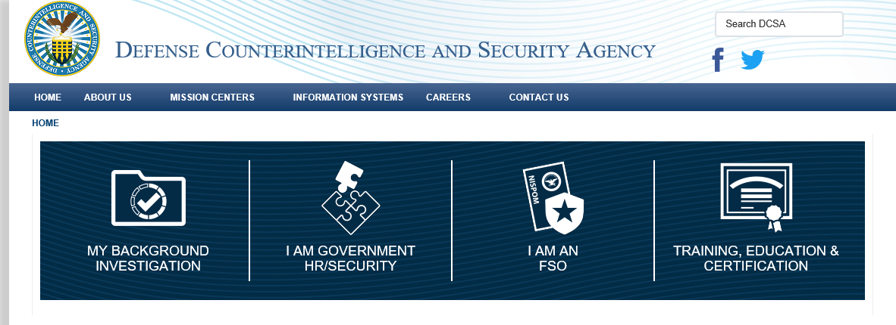
Locations to find help
The Help link when logged into DISS
This link provides the updated DISS user manual
https://www.dcsa.mil/
Rebecca Devore
407-243-4818
Rebecca.l.devore@lmco.com

